Slide 1
Introduction to Data Science Data Mining for Business Analytics
Brian d’Alessandro
Adjunct Professor, NYU
Fall 2015
Fine Print: these slides are, and always will be a work in progress. The material presented herein is original, inspired, or borrowed from others’ work. Where possible, attribution and acknowledgement will be made to content’s original source. Do not distribute, except for as needed as a pedagogical tool in the subject of Data Science.
Notes:
https://www.youtube.com/watch?v=aMDe5pODkB0 (harlan harris)

Slide 2
Matrix factorization based recommendations
Notes:
The goal of finding structure is to information from one source to reduce uncertainty about another source.
What does this mean? Conditional distribution example. I.e., carnival guy who guesses your weight. If I can see your height I can reduce uncertainty about weight.
Find some height/weight data.
Under supervised exploration:
How can we (automatically) obtain a selection of the more informative variables with respect to predicting the value of the target variable?
Even better, can we obtain the ranking of the variables?
Can think of importance as one that makes the target variable more pure. This leads to the notion of entropy.

Slide 3
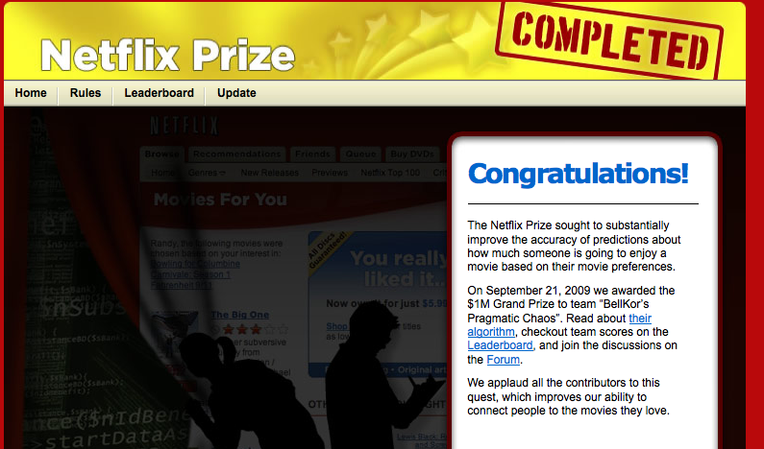
The netflix prize
The $1MM Netflix prize issued a renaissance of recommendation system techniques. Most notably, Matrix Factorizations become popular.

Slide 4
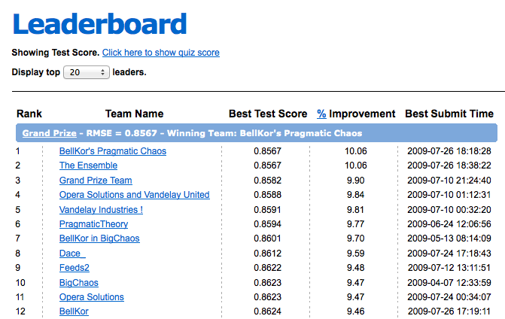
Multi-year development
It took several years to beat house algorithm by >10%

Slide 5
aftermath
The winning algorithm was never used…
“We evaluated some of the new methods offline but the additional accuracy gains that we measured did not seem to justify the engineering effort needed to bring them into a production environment.“
The leader after 1 year of development:
Reported more than 2000 hrs of work
Solution was a combination of 107 different algorithms
Do you think this was worth $1MM? Why?

Slide 6
A very important development
Despite not being adopted exactly, the collective research was very important for the development of recommender systems.
Given a ratings matrix, remember:
A = U Σ V^{T}
Instead of creating user taste, or item similarity neighborhoods, we can predict a user’s rating on an item by uncovering the latent dimensions of the ratings matrix.

Slide 7
Factorizing the ratings matrix
A = UV^{T}
We simplify the factorization to:
V
Each column of V represents a latent movie dimension. The value V_{ij} tells us how much movie i can be described by the latent movie dimension j.
U
Each element U_{ij} of U represents how much user i has an affinity for the latent movie dimension V_{j}.
Notes:
Show how a given rating decomposes to u*s*vt. Think of this is a linear combination of movie factors and users appreciation for those factors. V is how much that movie can be described by the factor. U is how important that factor is to the user and sig is how important that factor is compared to other factors in weighting tastes. I.e., we like 10 qualities of a movie, but we might weight the first 2 the most.

Slide 8








Latent factors (revisted)
We observe things like:
Crime
Thrillers
Artistic
Dramas
Handsome Leading Men

Slide 9
Latent factors (revisted)
What drives these observations? In other words, why do we do watch what we watch?
Genre (comedy vs. romance)
Audience (children vs. adults)
Style (quirky vs. serious)
Depth of Character
Presence of certain actors
We want a computerized way to be able to extract these properties and not rely on human curation.

Slide 10
Latent factors (revisted)
When uncovering latent factors, we usually only want a subset k, where k<<min(M,N)
U_{k}
V_{k}^{T}
 | Item 1 | Item 2 | Item 3 | … | Item M
LF 1 | -0.4 | 0.6 | 0.8 | … | -0.8
LF 2 | -0.8 | -0.5 | -0.7 | … | -0.4
LF 3 | 0.1 | 0.9 | 0.7 | … | -0.7
 | LF 1 | LF 1 | LF 3
User 1 | -0.7 | -0.8 | -0.4
User 2 | 0.2 | -0.6 | 1.0
User 3 | -0.8 | -0.1 | -0.8
User 4 | 0.4 | 0.3 | -0.1
…
User N | -0.3 | 1.0 | 0.4

Slide 11
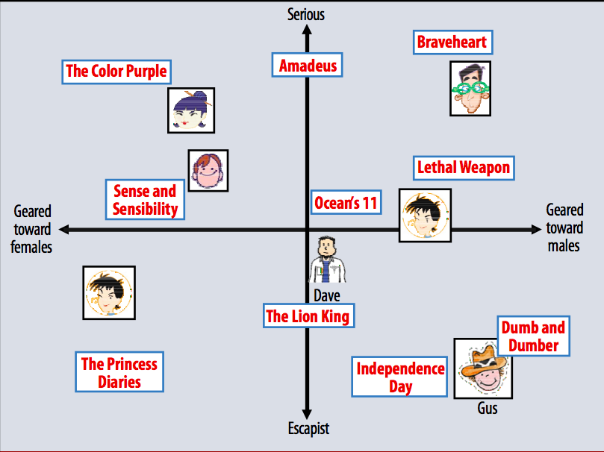
Latent factors (revisted)
An example set of movies and how they load on two latent variables.

Slide 12
The rating prediction
The rating prediction for user i on item j is then an inner product between the the user’s preferences for each latent factor and the item’s strength on that factor.
v_{jt} indicates how much factor t describes item j
r_{ij} = u_{i1}* v_{j1} + u_{i2}* v_{j2} + … + u_{ik}* v_{jk} = Σ_{t=1,k} u_{it} * v_{jt}
u_{it} indicates how user i prefers factor t

Slide 13
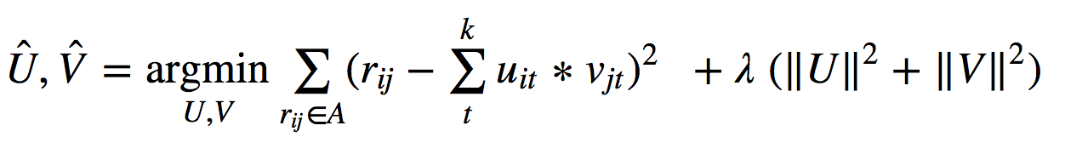
Learning the factorization
We can set this recommendation problem up as a supervised learning problem.
Minimize the sum of squares predictions of observed ratings.
We regularize the components of U and V to avoid over-fitting

Slide 14
A clustering approach
Again we start with the user-item matrix. This time we want to cluster items into similar groups. However, clustering with incredibly high dimension (in this case, the number of users) is a daunting task.
 | Item 1 | Item 2 | Item 3 | Item 4 | … | Item K
User 1 | 2 | 1 |  |  | …
User 2 |  | 2 | 4 |  | … | 2
User 3 | 3 |  |  |  | …
User 4 | 1 | 2 | 5 | 3 | …
User 5 | 3 | 2 |  |  | …
User 6 |  |  |  |  | … | 1
User 7 |  | 4 | 1 |  | … | 4
User 8 |  | 4 | 2 |  | … | 5
User 9 | 1 |  |  |  | …
User 10 |  |  | 3 | 4 | … | 1
… | … | … | … | … | …
User N |  |  |  | 1 | … | 4
A =

Slide 15
Reduce the dimension
A = U Σ V^{T}
Compute SVD of A:
V_{k}
Take first k columns of V:
Cluster items into groups using V_{k,} create item neighborhoods based on the cluster assignments.

Slide 16
What is v_{k}?
V represents the right singular vectors of A.
Each RSV can be considered a concept or latent dimension of A
The first k right singular vectors contribute the most to the matrix A
Each value in V_{k} reflects how important item is is to that particular latent dimension
 | RSV 1 | RSV 2 | RSV 3 | RSV 4 | … | RSV K
Item 1 | 0.1 | 0.15 | 0.41 | 0.14 | … | 0.9
Item 2 | 0.4 | 0.1 | 0.4 | 0.4 | … | 0.4
Item 3 | 0.2 | 0.32 | 0.2 | 0.42 | … | 0.2
Item 4 | 0.6 | 0.4 | 0.76 | 0.6 | … | 0.6
… | … | … | … | … | … | …
Item M | 0.6 | 0.8 | 0.05 | 0.1 | … | 0.6
V_{k} =

